Slide 1
Chapter 1 Introduction to Computers, Programs, and Python

Slide 2
Objectives
To understand computer basics, programs, and operating systems (§§1.2-1.4).
To write and run a simple Python program (§1.5).
To explain the basic syntax of a Python program (§1.5).
To describe the history of Python (§1.6).
To explain the importance of, and provide examples of, proper programming style and documentation (§1.7).
To explain the differences between syntax errors, runtime errors, and logic errors (§1.8).
To create a basic graphics program using Turtle (§1.9).

Slide 3
What is a Computer?
A computer consists of a CPU, memory, hard disk, input/output devices, and communication devices.

Slide 4
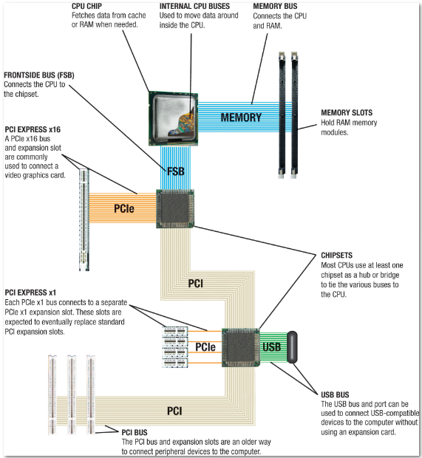
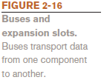
Buses and Expansion Slots

Slide 5

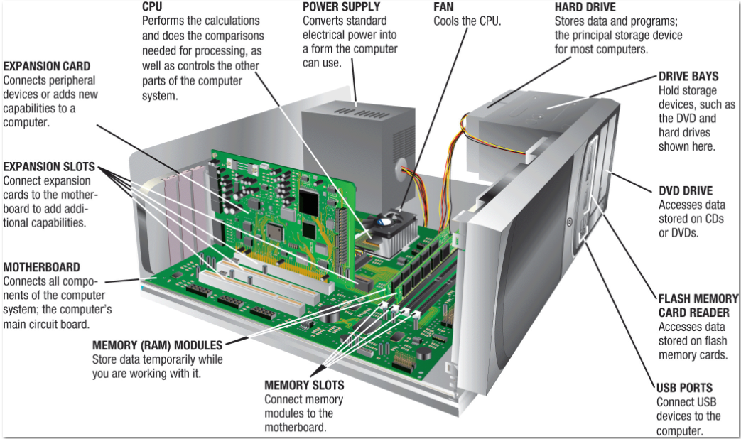
Inside a Desktop System Unit

Slide 6
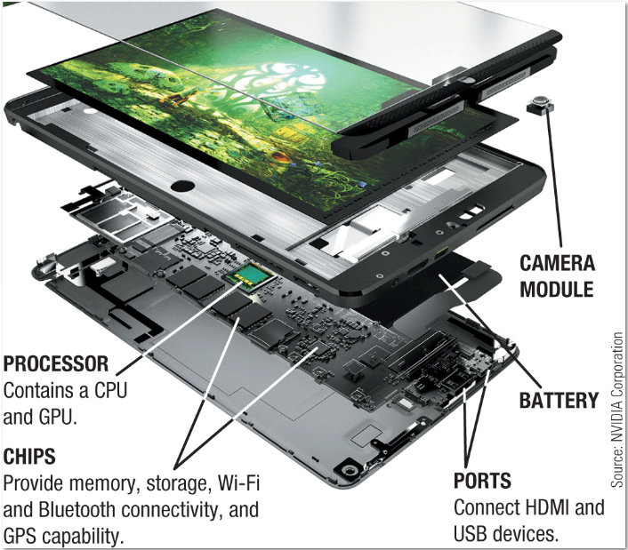

Inside a Tablet System Unit

Slide 7
CPU
The central processing unit (CPU) is the brain of a computer. It retrieves instructions from memory and executes them. The CPU speed is measured in gigahertz (GHz), with 1 gigahertz equaling 1 billion pulses per second. The speed of the CPU has been improved continuously. If you buy a PC now, you can get an Intel 5 Core or 7 Core Processor at 3 gigahertz.

Slide 8
Memory
Memory is to store data and program instructions for CPU to execute. A memory unit is an ordered sequence of bytes, each holds eight bits. A program and its data must be brought to memory before they can be executed. A memory byte is never empty, but its initial content may be meaningless to your program. The current content of a memory byte is lost whenever new information is placed in it.

Slide 9
How Data is Stored?
Data of various kinds, such as numbers, characters, and strings, are encoded as a series of bits (zeros and ones). Computers use zeros and ones because digital devices have two stable states, which are referred to as zero and one by convention. The programmers need not to be concerned about the encoding and decoding of data, which is performed automatically by the system based on the encoding scheme. The encoding scheme varies. For example, character ‘J’ is represented by 01001010 in one byte. A small number such as three can be stored in a single byte. If computer needs to store a large number that cannot fit into a single byte, it uses a number of adjacent bytes. No two data can share or split a same byte. A byte is the minimum storage unit.

Slide 10
Storage Devices
Memory is volatile, because information is lost when the power is off. Programs and data are permanently stored on storage devices and are moved to memory when the computer actually uses them. There are three main types of storage devices:Disk drives (hard disks and floppy disks), CD drives (CD-R and CD-RW), and Tape drives.

Slide 11
Output Devices: Monitor
The monitor displays information (text and graphics). The resolution and dot pitch determine the quality of the display.

Slide 12
Monitor Resolution and Dot Pitch
resolution
The resolution specifies the number of pixels per square inch. Pixels (short for “picture elements”) are tiny dots that form an image on the screen. The resolution can be set manually. The higher the resolution, the sharper and clearer the image is. However, the image may be very small if you set high resolution on a small screen monitor. PC monitors are usually 15-inch, 17-inch, 19-inch, or 21-inch. For a 15-inch monitor, a comfortable resolution setting would be 640×480 (307,200 pixels).
dot pitch
The dot pitch is the amount of space between pixels. The smaller the dot pitch, the better the display.

Slide 13
Communication Devices
A regular modem uses a phone line and can transfer data in a speed up to 56,000 bps (bits per second). A DSL (digital subscriber line) also uses a phone line and can transfer data in a speed 20 times faster than a regular modem. A cable modem uses the TV cable line maintained by the cable company. A cable modem is as fast as a DSL. Network interface card (NIC) is a device to connect a computer to a local area network (LAN). The LAN is commonly used in business, universities, and government organizations. A typical type of NIC, called 10BaseT, can transfer data at 10 mbps (million bits per second).

Slide 14
Programs
Computer programs, known as software, are instructions to the computer.
You tell a computer what to do through programs. Without programs, a computer is an empty machine. Computers do not understand human languages, so you need to use computer languages to communicate with them.
Programs are written using programming languages.

Slide 15
Programming Languages
Machine Language Assembly Language High-Level Language
Machine language is a set of primitive instructions built into every computer. The instructions are in the form of binary code, so you have to enter binary codes for various instructions. Programming with native machine language is a tedious process. Moreover the programs are highly difficult to read and modify. For example, to add two numbers, you might write an instruction in binary like this:
1101101010011010

Slide 16
Programming Languages
Machine Language Assembly Language High-Level Language
Assembly languages were developed to make programming easy. Since the computer cannot understand assembly language, however, a program called assembler is used to convert assembly language programs into machine code. For example, to add two numbers, you might write an instruction in assembly code like this:
ADDF3 R1, R2, R3

Slide 17
Programming Languages
Machine Language Assembly Language High-Level Language
The high-level languages are English-like and easy to learn and program. For example, the following is a high-level language statement that computes the area of a circle with radius 5:
area = 5 * 5 * 3.1415

Slide 18
Popular High-Level Languages
COBOL (COmmon Business Oriented Language)
FORTRAN (FORmula TRANslation)
Java (Developed by Sun, now part of Oracle)
BASIC (Beginner All-purpose Symbolic Instructional Code)
Pascal (named for Blaise Pascal)
Ada (named for Ada Lovelace)
C (whose developer designed B first)
Visual Basic (Basic-like visual language developed by Microsoft)
Delphi (Pascal-like visual language developed by Borland)
C++ (an object-oriented language, based on C)
C# (a Python-like language developed by Microsoft)
Python (We use it in the book)

Slide 19
Compiling Source Code
A program written in a high-level language is called a source program. Since a computer cannot understand a source program. Program called a compiler is used to translate the source program into a machine language program called an object program. The object program is often then linked with other supporting library code before the object can be executed on the machine.

Slide 20
Operating Systems
The operating system (OS) is a program that manages and controls a computer’s activities. You are probably using a Mac or Windows machine. Windows is currently the most popular PC operating system. Application programs such as an Internet browser and a word processor cannot run without an operating system.

Slide 21
What is Python?
General Purpose Interpreted Object-Oriented
Python is a general purpose programming language. That means you can use Python to write code for any programming tasks. Python are now used in Google search engine, in mission critical projects in NASA, in processing financial transactions at New York Stock Exchange.

Slide 22
What is Python?
General Purpose Interpreted Object-Oriented
Python is interpreted, which means that python code is translated and executed by an interpreter one statement at a time. In a compiled language, the entire source code is compiled and then executed altogether.

Slide 23
What is Python?
General Purpose Interpreted Object-Oriented
Python is an object-oriented programming language. Data in Python are objects created from classes. A class is essentially a type that defines the objects of the same kind with properties and methods for manipulating objects. Object-oriented programming is a powerful tool for developing reusable software.

Slide 24
Python’s History
created by Guido van Rossum in Netherlands in 1990
Open source

Slide 25
Python 2 vs. Python 3
Python 3 is a newer version, but it is not backward compatible with Python 2. That means if you write a program using Python 2, it may not work on Python 3.

Slide 26
Announcement by
Hannah - Women in ECE
Instagram: Wieceucsb

Slide 27
Updates to Welcome doc
Syllabus related

Slide 28
Different Ways to Program in Python
IDLE
Online Python Interpreter (e.g. Programiz)
CoLab
Visual Studio Code
Pycharm
Spyder
Jupyter Notebooks, Jupyter Lab
Anaconda
Repl.it

Slide 29
Form questions
Why learn any programming language when you can use AI tools to generate code?
Mention three aspects of the Python language that you learned in last lecture on Monday.
Share an activity that helped you engage with the class material before.

Slide 30
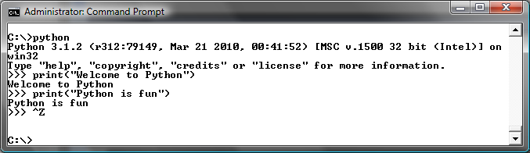
Launch Python

Slide 31
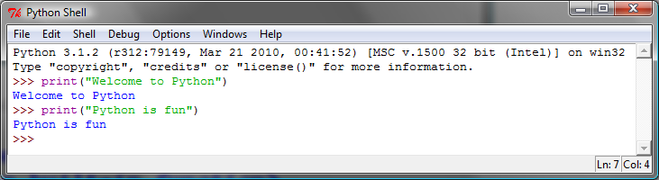
Launch Python IDLE

Slide 32
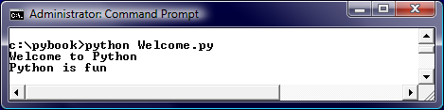
Run Python Script

Slide 33
A Simple Python Program
Listing 1.1
# Display two messages
print("Welcome to Python")
print("Python is fun")
Welcome
Note: Clicking the green button displays the source code with interactive animation. You can also run the code in a browser. Internet connection is needed for this button.

Slide 34

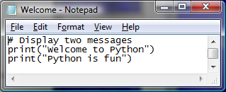
Creating and Editing Using Notepad
To use Notepad, type
notepad Welcome.py
from the DOS prompt.

Slide 35
Trace a Program Execution
animation
Execute a statement
# Display two messages
print("Welcome to Python")
print("Python is fun")

Slide 36
Trace a Program Execution
animation
Execute a statement
# Display two messages
print("Welcome to Python")
print("Python is fun")

Slide 37
Two More Simple Examples
WelcomeWithThreeMessages
ComputeExpression

Slide 38
Supplements on the Companion Website
Companion Website
See Supplement I.B for installing and configuring Python
See Supplement I.C for developing Python programs from Eclipse
www.cs.armstrong.edu/liang/py

Slide 39
Anatomy of a Python Program
Statements
Comments
Indentation

Slide 40
Statement
A statement represents an action or a sequence of actions. The statement print("Welcome to Python") in the program in Listing 1.1 is a statement to display the greeting "Welcome to Python“.
# Display two messages
print("Welcome to Python")
print("Python is fun")

Slide 41
Indentation
The indentation matters in Python. Note that the statements are entered from the first column in the new line. It would cause an error if the program is typed as follows:
# Display two messages
print("Welcome to Python")
print("Python is fun")

Slide 42
Indentation
# Four digit number reversal
fdn = input("Please enter a four digit number:")
fdnr = ""
for i in range(0, len(fdn)):
fdnr += fdn[len(fdn)-i-1]
print(fdnr)

Slide 43
Special Symbols (Comments)

Slide 44
Programming Style and Documentation
Appropriate Comments
Proper Indentation and Spacing Lines

Slide 45
Appropriate Comments
Include a summary at the beginning of the program to explain what the program does, its key features, its supporting data structures, and any unique techniques it uses.
Include your name, class section, instructor, date, and a brief description at the beginning of the program.

Slide 46
Proper Indentation and Spacing
Indentation
Indent four spaces (see PEP8 documentation).
A consistent spacing style makes programs clear and easy to read, debug, and maintain.
Spacing
Use blank line to separate segments of the code.

Slide 47
Examples of Indentation
Code examples

Slide 48
Programming Errors
Syntax Errors
Error in code construction
Runtime Errors
Causes the program to abort
Logic Errors
Produces incorrect result

Slide 49
Examples of Syntax Errors
improper indentation;
strings not properly enclosed in quotes;
statements that run over a line without proper parentheses or backslash \;
the print statement missing parenthesis;
arithmetic/logic expressions that are nor properly formed.
-- Source: Runestone Academy

Slide 50
Examples of Runtime Errors
Misspelled or incorrectly capitalized variable and function names
Attempts to perform operations (such as math operations) on data of the wrong type (ex. attempting to subtract two variables that hold string values)
Dividing by zero
Attempts to use a type conversion function such as int on a value that can’t be converted to an int
-- Source: Runestone Academy

Slide 51
Examples of Logic (Semantic) Errors
Program runs and finishes but produces the (logically) wrong result.
Example:
num1 = input('Enter a number:')
num2 = input('Enter another number:')
sum = num1 + num2
print('The sum of', num1, 'and', num2, 'is', sum)
Examples: Mathematical formulas, logical expressions, loop limit conditions
-- Source: Runestone Academy

Slide 52
Getting Started with GUI Programming
Why GUI? Turtle Tkniter
GUI is a great pedagogical tool to motivate studetns and stimulate student interests in programming.

Slide 53
Getting Started with GUI Programming
Why GUI? Turtle Tkniter
A simple way to start graphics programming is to use Python built-in Turtle package.
A Turtle Example

Slide 54
Getting Started with GUI Programming
Why GUI? Turtle Tkniter
Later in the book, we will also introduce Tkinter for developing comprehensive GUI applications.
A Tkinter Example

